Slide 1
Finite Automata with Output
Automata Theory
Ege University
Department of Computer Engineering
Yrd. Doç. Dr. R. Cenk Erdur, 2012

Slide 2
F.A. With Output
Moore Machine
Mealey Machine
Yrd. Doç. Dr. R. Cenk Erdur, 2012

Slide 3
Moore Machines
A Moore machine a collection of five things:
  A finite set of states (q0, q1, q2, ....) where q0 is the start state.
  An alphabet of letters for forming the input string.
  An alphabet of possible output characters.
  A transition table that shows for each state and each input letter what state is reached next.
  An output table that shows what character from output characters alphabet is printed by each state as it is entered.
Yrd. Doç. Dr. R. Cenk Erdur, 2012

Slide 4
Moore Machine Example-1
Input:abab Output:10010
b
a
q₀ / 1
q₁ / 0
b
a
a
b
a
q₂ / 0
q₃ / 1
b
Yrd. Doç. Dr. R. Cenk Erdur, 2012

Slide 5
Moore Machine Example-2
A Moore Machine that counts the number of “aab" in a given string:
a
b
a
q₀ / 0
q₁ / 0
a
q₂ / 0
b
q₃ / 1
b
a
b
Yrd. Doç. Dr. R. Cenk Erdur, 2012

Slide 6
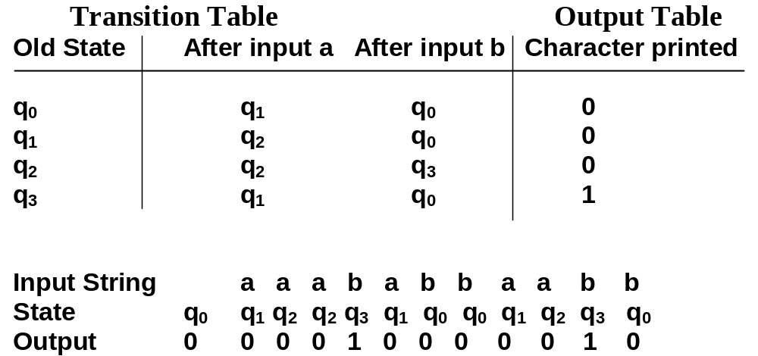
Moore Machine Example-2
“Transition” and “Output” Tables for Example-2:
Yrd. Doç. Dr. R. Cenk Erdur, 2012

Slide 7
Mealey Machine
A Mealy Machine is a collection of four things:
  A finite set of states (q0, q1, q2, ....) where q0 is the start state.
  An alphabet of letters for forming the input string.
  An alphabet of possible output characters.
  A pictorial representation with states represented by small circles and directed edges indicating transitions between states. Each edge is labeled with a compound symbol of the form i/o, where i is an input letter and o is an output character.
Yrd. Doç. Dr. R. Cenk Erdur, 2012

Slide 8
Example-1
Mealey Machine for 1’s complement:
0/1, 1/0
q₀
Yrd. Doç. Dr. R. Cenk Erdur, 2012

Slide 9
Example-2
Mealey Machine for incrementing a number by 1:
0/0, 1/1
No
Carry
0/1
Input:1011
Output:1100
Start
0/1
1/0
Note: For this example,
input is given begining
from the rightmost bit,
and output is formed from
right to left.
1/0
Owe
Carry
Yrd. Doç. Dr. R. Cenk Erdur, 2012

Slide 10
Example-3
Mealey Machine that finds the number of aa and bb’s:
a/1
1
Input:aaa
Output:011
Input:ababbaab
Output:00001010
a/0
a/0
b/0
S
b/1
b/0
2
Yrd. Doç. Dr. R. Cenk Erdur, 2012

Slide 11
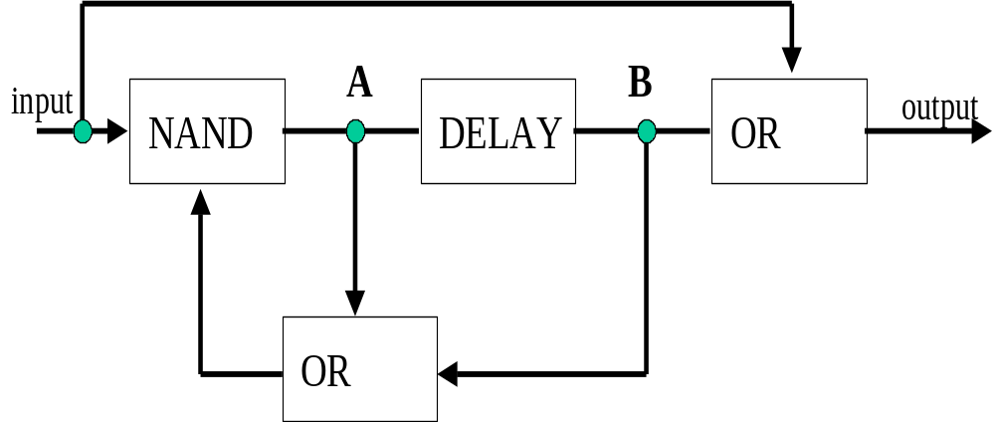
Example -4
“Sequential” logic circuits can be modeled using Mealey Machines. An example is given below:
Yrd. Doç. Dr. R. Cenk Erdur, 2012

Slide 12
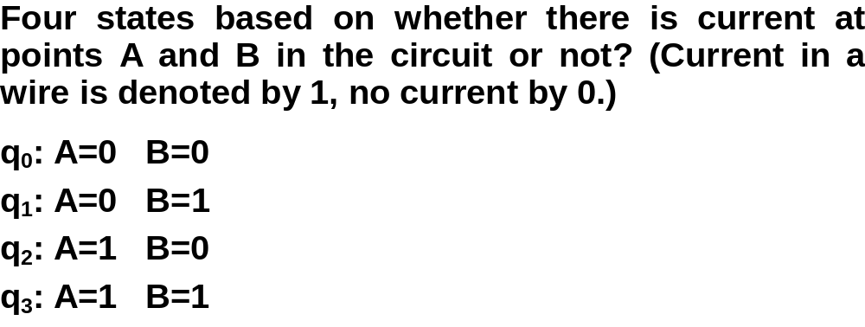
Example- 4
Yrd. Doç. Dr. R. Cenk Erdur, 2012

Slide 13
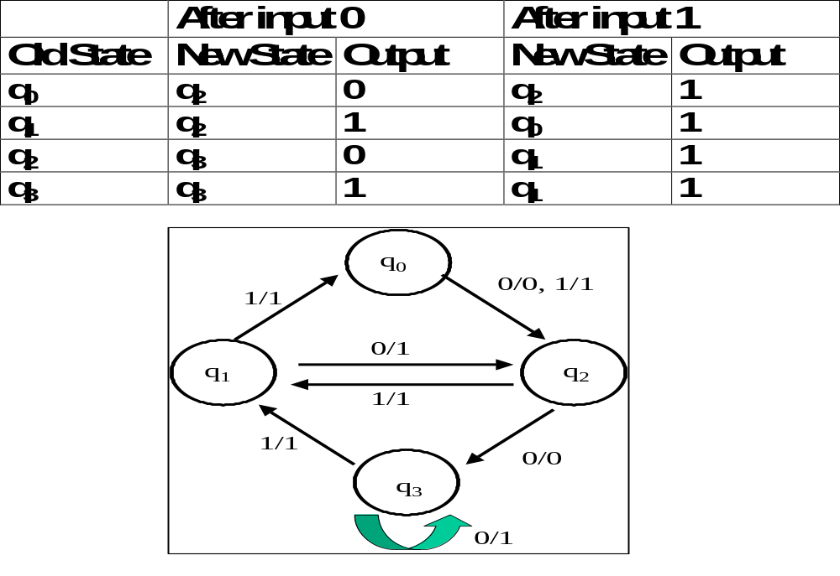
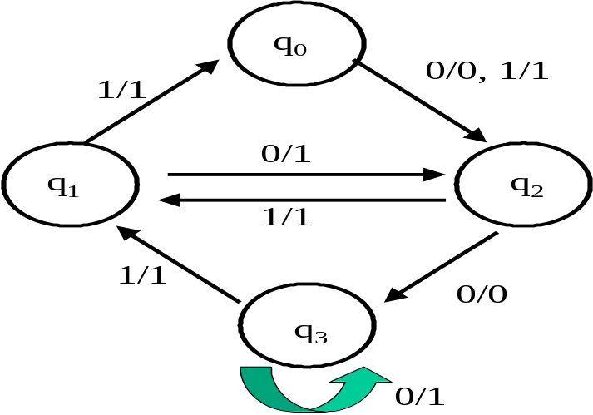
Example-4
After input 0
After input 1
Old State
New State
Output
New State
Output
q₀
q₂
0
q₂
1
q₁
q₂
1
q₀
1
q₂
q₃
0
q₁
1
q₃
1
q₁
1
Yrd. Doç. Dr. R. Cenk Erdur, 2012
q₃

Slide 14
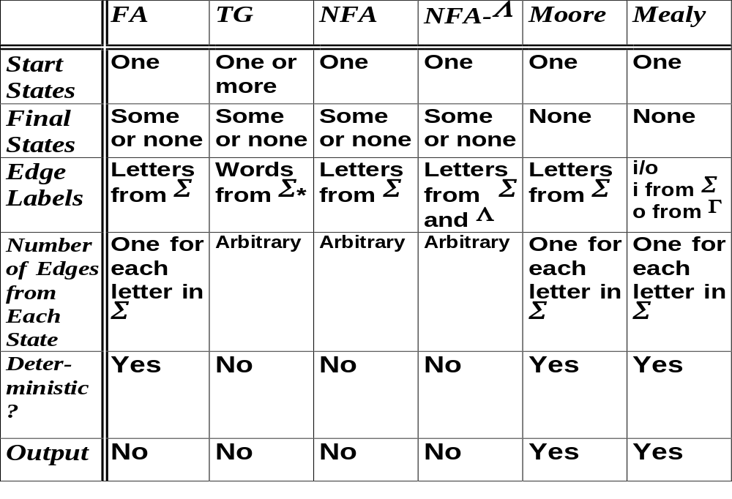
Comparison Table for All FA Models
Yrd. Doç. Dr. R. Cenk Erdur, 2012

